Slide 1


Slide 2
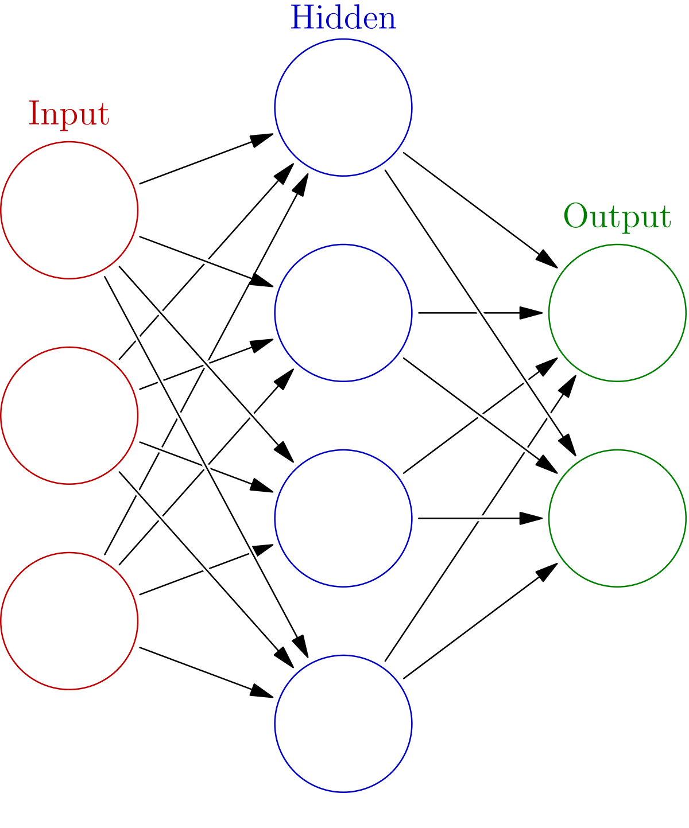


An idea
+
LOCATION
=

Slide 3
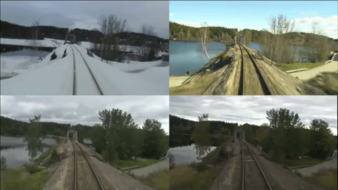
Possible ways of use
Detecting interesting places for traveler, e. g. train passengers can use their phones to seek attractions while they are traveling
Offline navigation
Etc.

Slide 4
Steps of solving

Slide 5


paperswithcode.com/task/visual-place-recognition
bit.ly/2YmNoXs

Slide 6
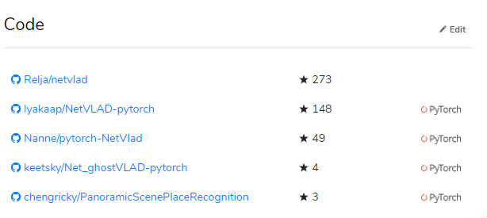

Slide 7
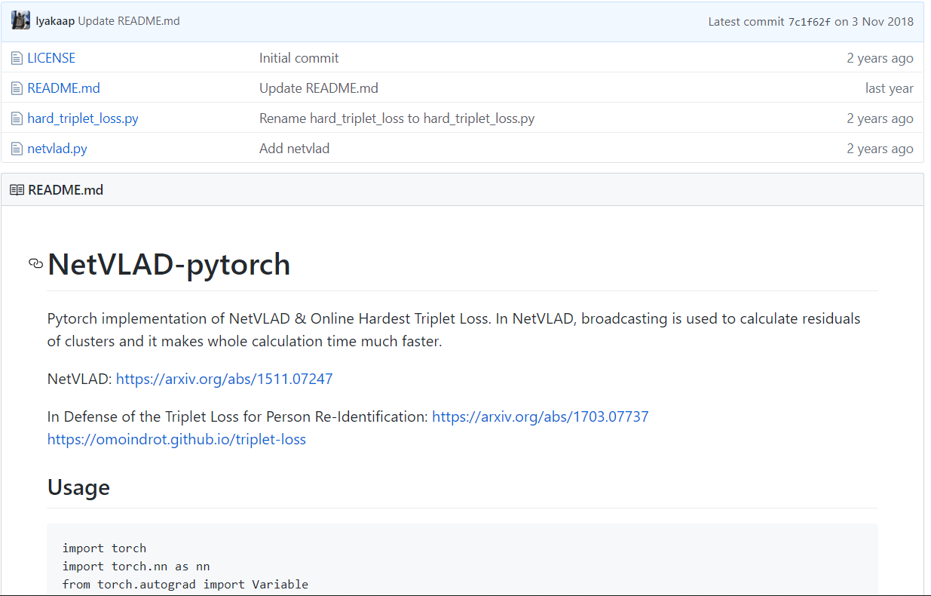

Slide 8

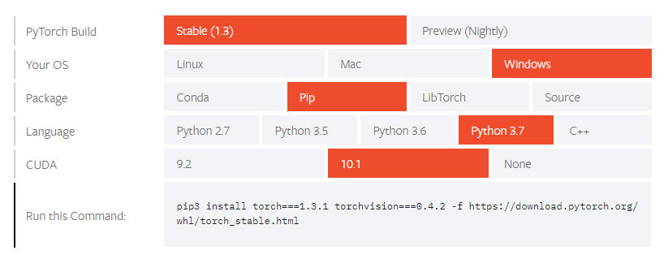
pytorch.org/get-started/locally/
bit.ly/2Rup7gO

Slide 9


developer.nvidia.com/cuda-downloads bit.ly/2Rup7gO

Slide 10
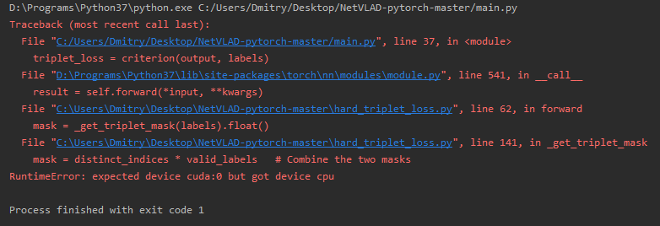
Fix pytorch bugs

Slide 11
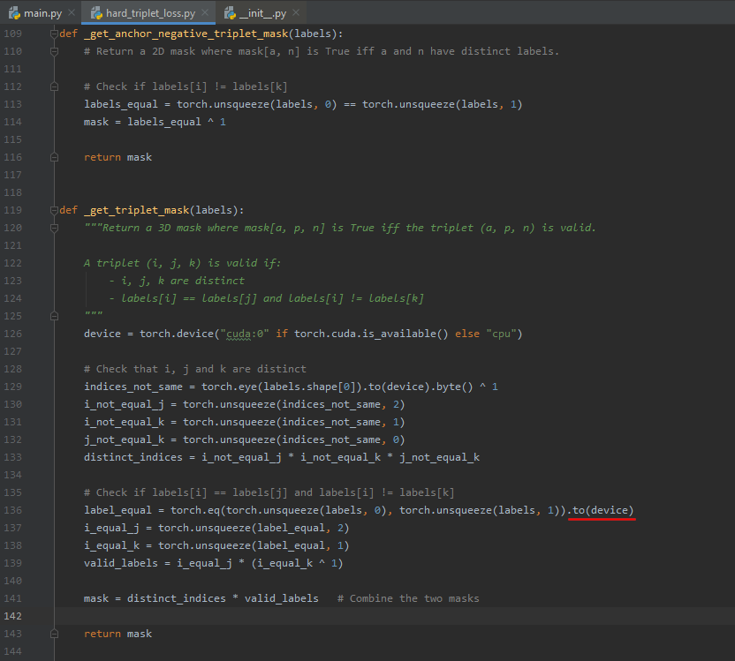
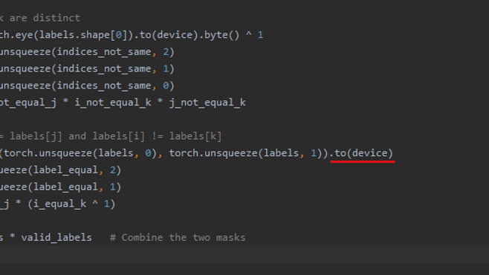
Fix pytorch bugs

Slide 12
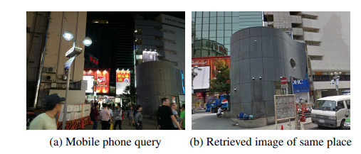
NetVLAD (Vector of Locally Aggregated Descriptors)

Slide 13
Embedding (Вкладення)
An embedding is a mapping of a discrete — categorical — variable to a vector of continuous numbers. In the context of neural networks, embeddings are low-dimensional, learned continuous vector representations of discrete variables. Neural network embeddings are useful because they can reduce the dimensionality of categorical variables and meaningfully represent categories in the transformed space.

Slide 14
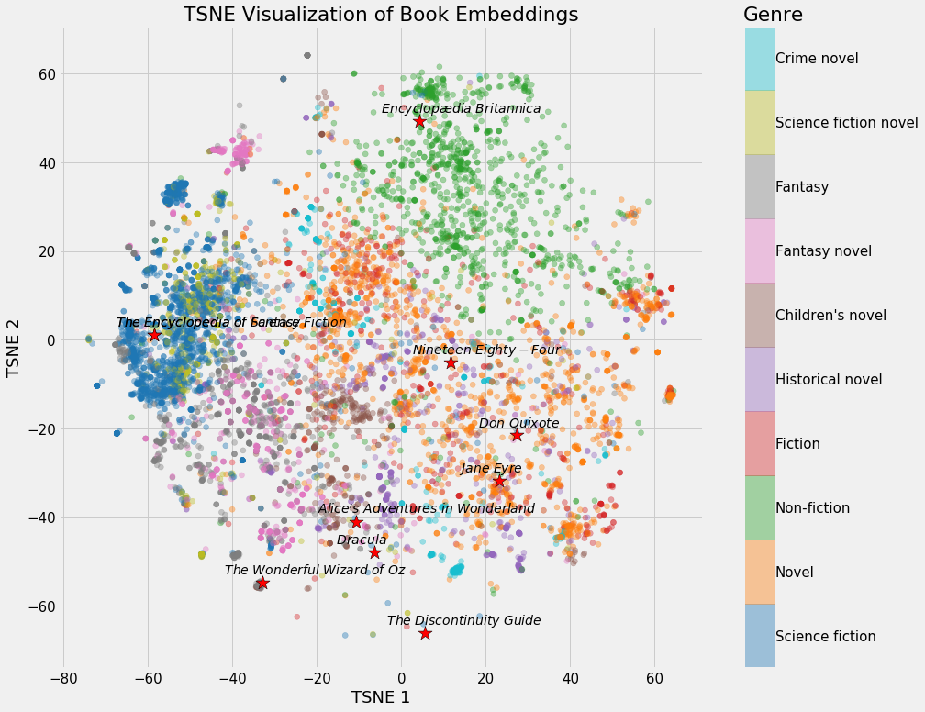
Neural network embeddings have 3 primary purposes:
Finding nearest neighbors in the embedding space. These can be used to make recommendations based on user interests or cluster categories.
As input to a machine learning model for a supervised task.
For visualization of concepts and relations between categories.

Slide 15
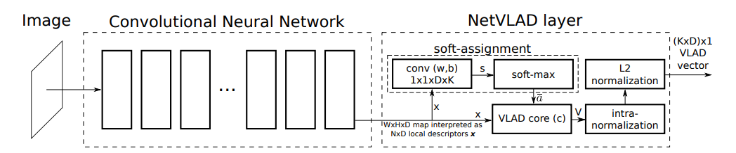
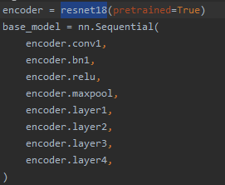
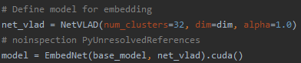
Convolutional Neural Network architecture with the NetVLAD layer
Vector of Locally Aggregated Descriptors
(Embedding)

Slide 16
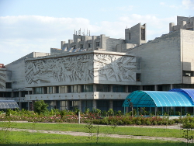
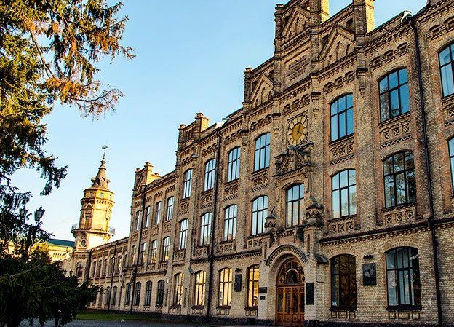

Simple demo
Distinguish by a photo whether you at CSC faculty building or KPI first building

Slide 17
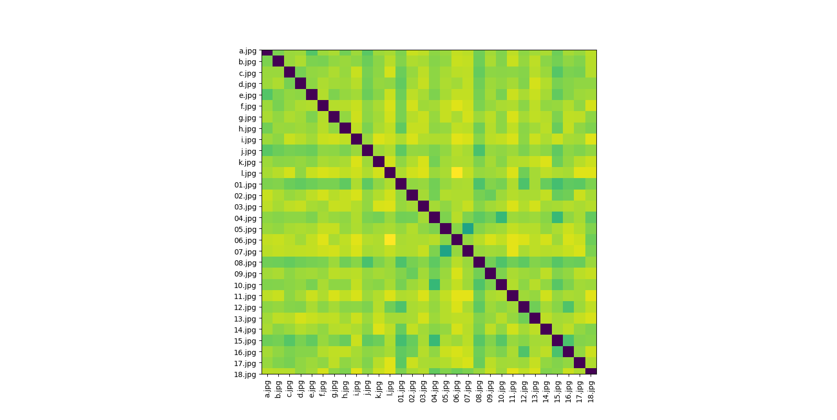
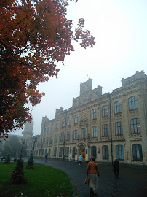
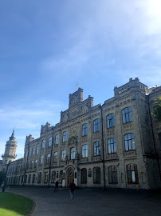
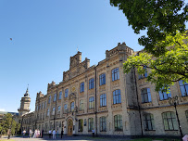
Pair-wise “distance” between each two images
10.jpg - Compare image
04.jpg - Original image
15.jpg - Compare image

Slide 18
What do we have by the end?
We can check if some photo corresponds some place and restore position

Slide 19
Why this approach is better then other
It is scalable
(very much scalable)

